Slide 1
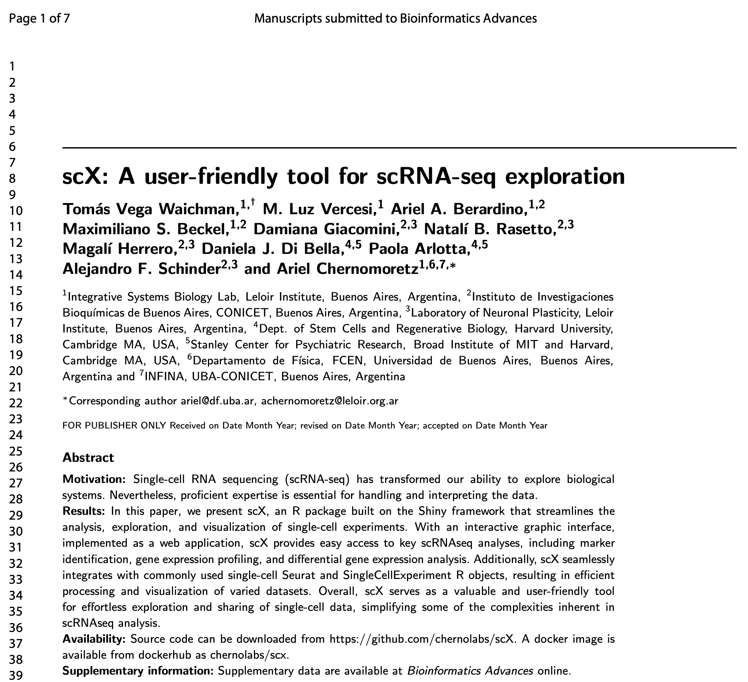

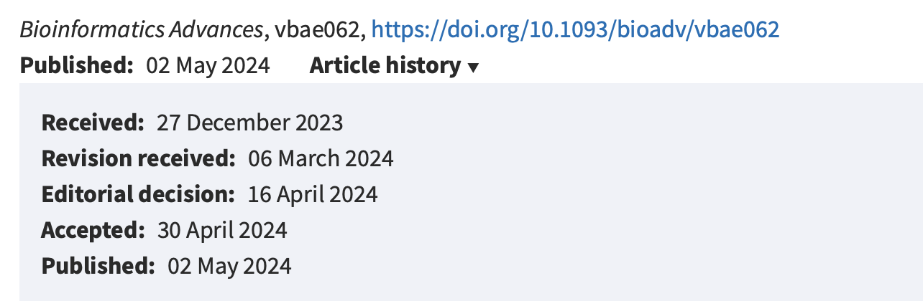
5-21-24 code review
Ty Bottorff – Bioinformatics postdoc
Linsley lab

Slide 2
Motivation
Alternative to BAP for scRNAseq datasets
Inspiration for new BAP functionalities

Slide 3
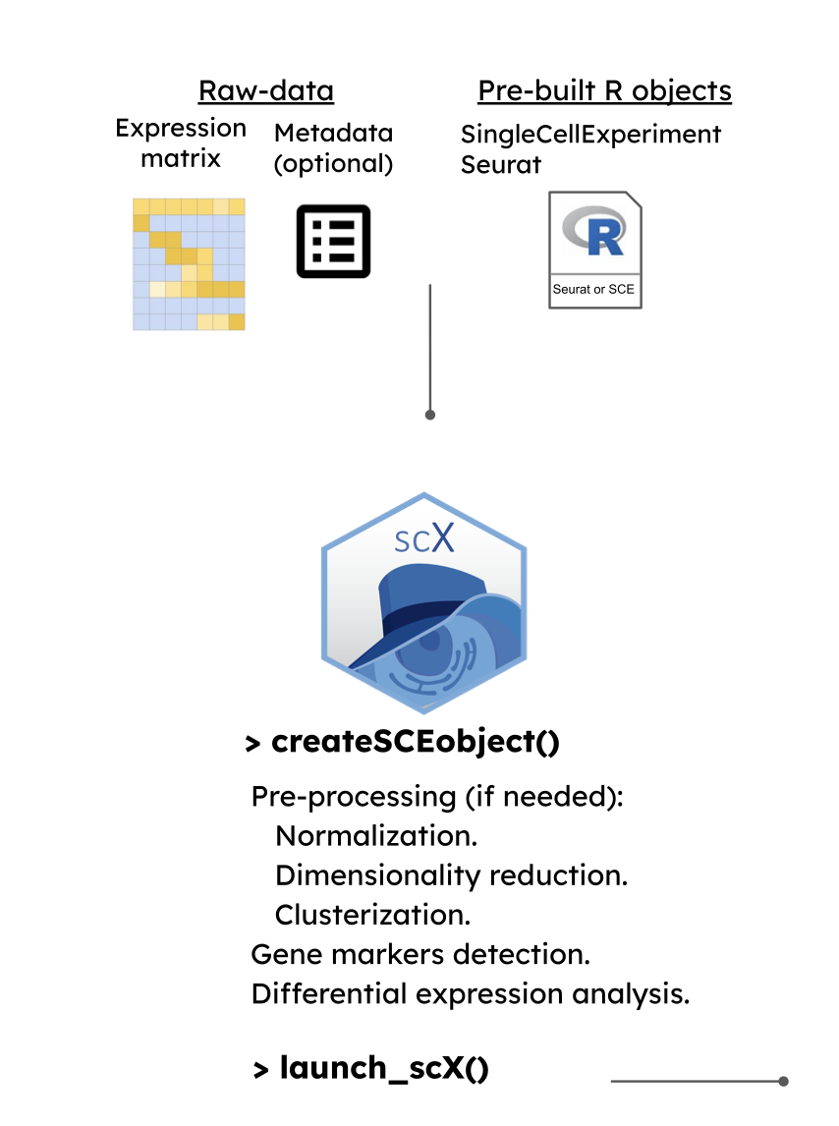
Preparing for launch_scX()
createSCEobject()
Leverages ‘scran’ Bioconductor package functionalities
Louvain clustering over mutual-K nearest neighbor graph (k = 20)
20 largest PCA components
Can specify NNGraphParam object (bluster Bioconductor package) to control clustering
findMarkers function for DEGs/markers
Notes:
createSCEobject function executes a series of computational steps leveraging the functionality implemented in the ’scran’ Bioconductor package.We adopted a normalization by deconvolution scheme (Lun et al., 2016) to eliminate systematic differences between libraries The identification of the most variable features involves fitting a trend on the variance vs. mean of log-normalized expression profiles and identifying genes with a positive biological variance component. If requested, a graph- based cell clustering procedure can be implemented. By default, it performs a Louvain clustering over a mutual-K nearest neighbor graph (k=20) estimated considering Euclidean cell-cell distances in the sub-space spanned by the 20 largest PCA components. It is also possible to specify any other graph-based clustering method available from the igraph package. Advanced users can directly specify an NNGraphParam object (from the bluster Bioconductor package) to achieve maximum control in the specification of this graph-based clustering task. Differential expression analysis and marker identification are conducted on one or more user- specified partitions, relying on the functionality implemented in the ’findMarkers’ function. For marker identification, a Wilcoxon rank sum test is considered by default, but other options (t-test, binomial test) can also be specified. For every cluster, pairwise tests are performed against any other cluster and, by default, genes are ranked based on the maximal observed p-val (pval.type=’all’ in the paramFindMarkers input parameter). Optionally, the user can adopt other strategies to consolidate DE signals. Furthermore, ad-hoc pre-calculated lists of markers can also be provided

Slide 4
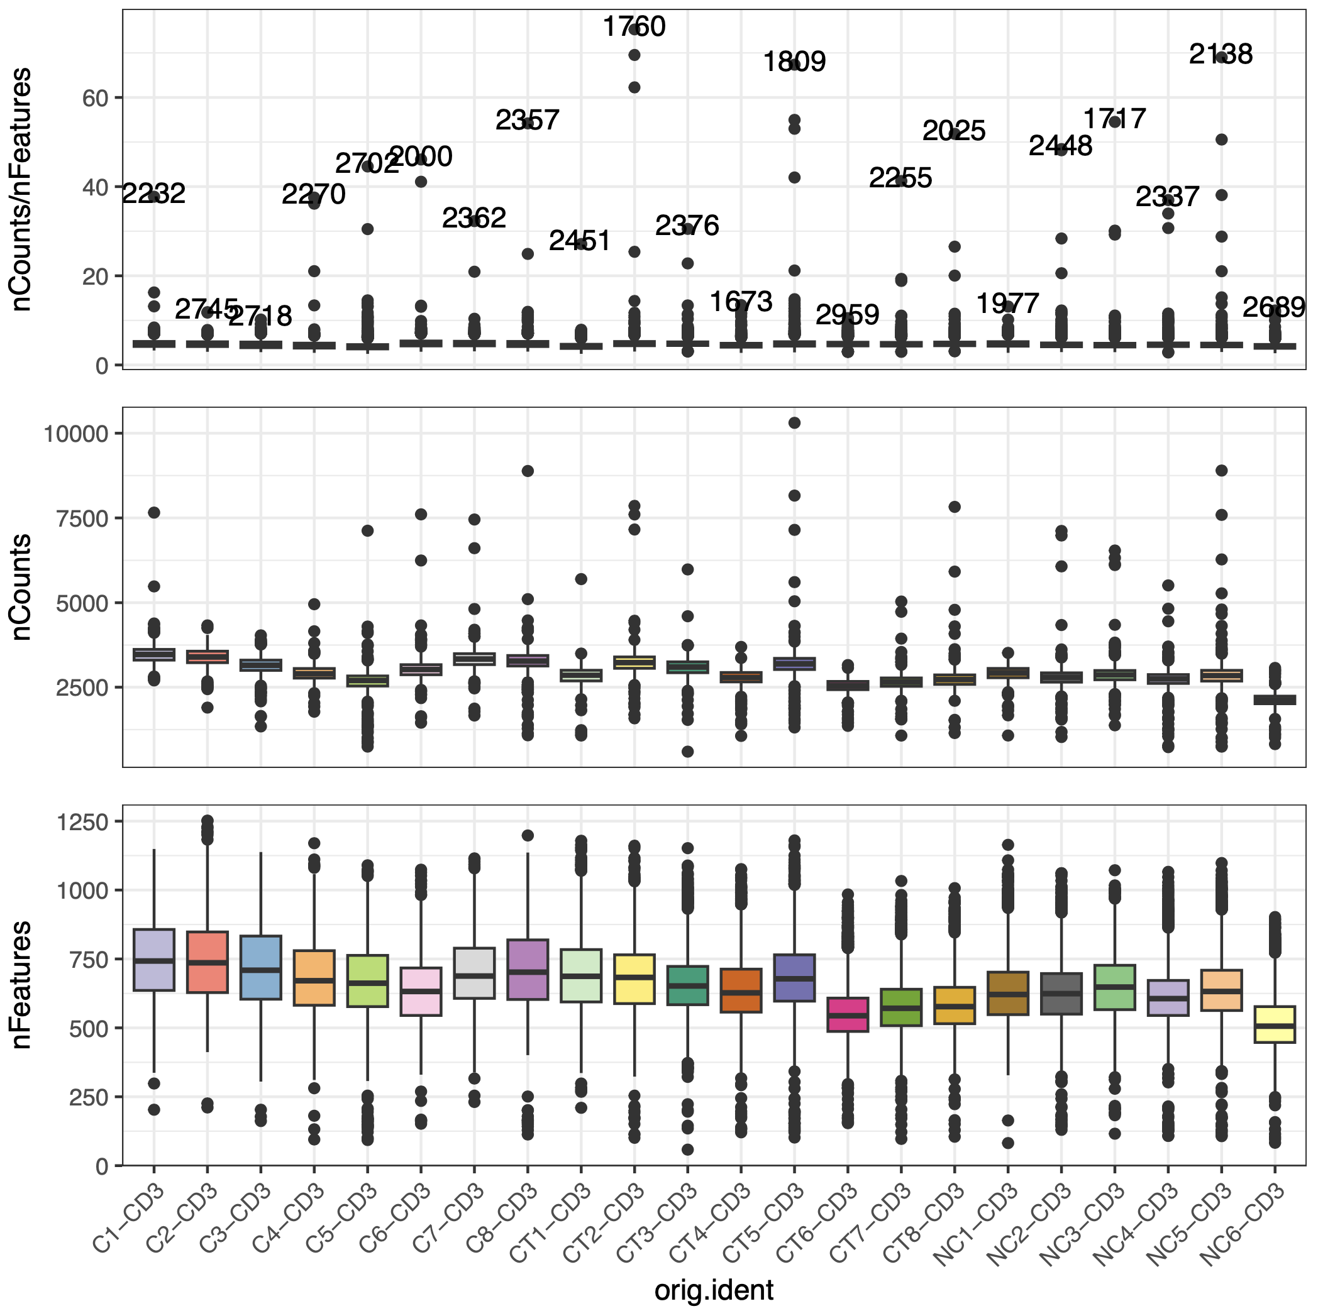
Summary module
QC plots by metadata vars

Slide 5
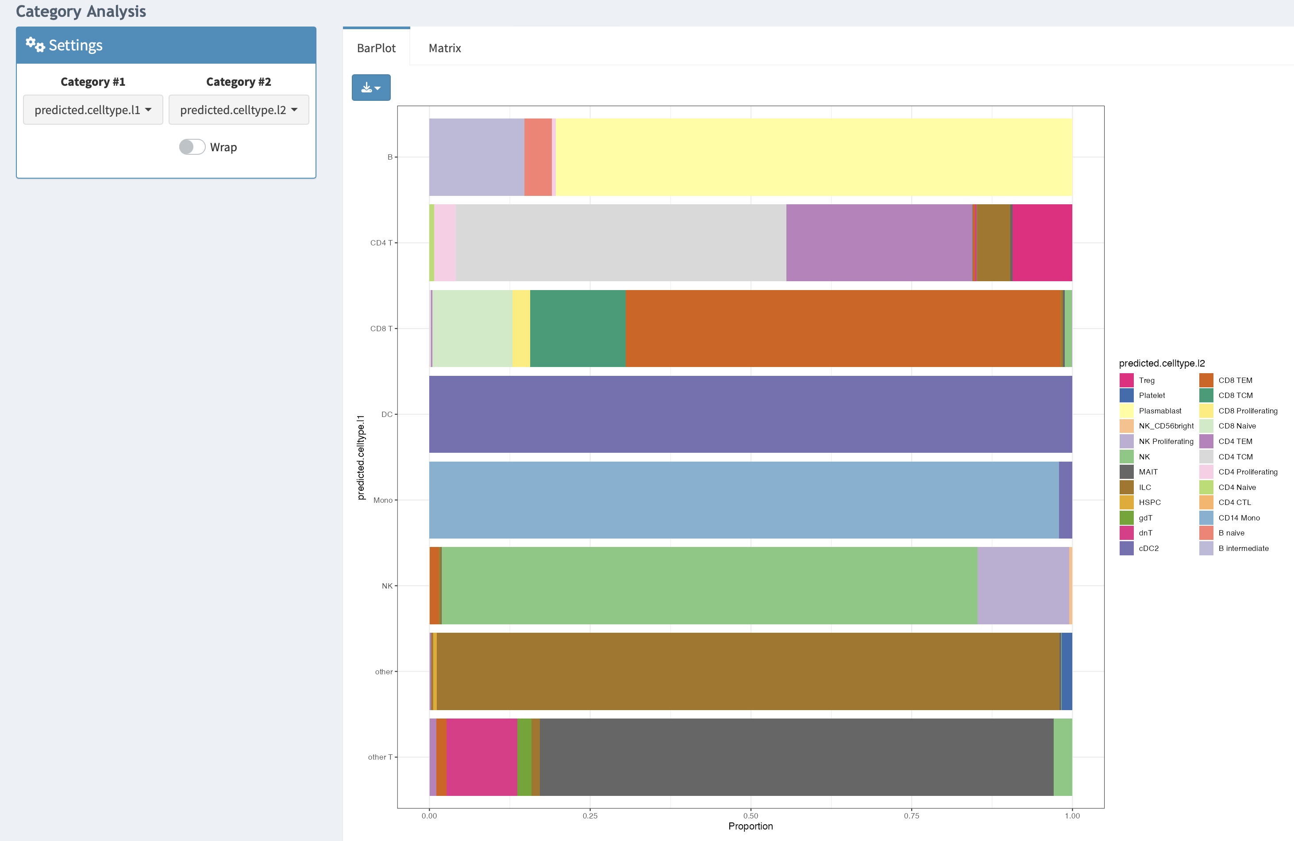
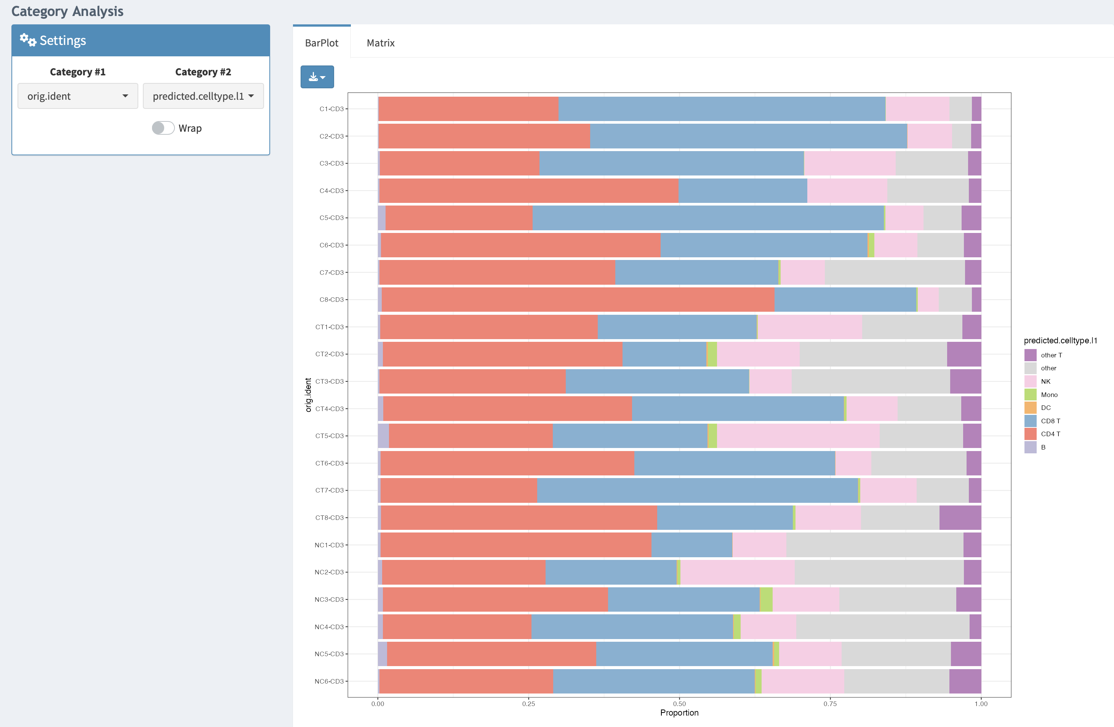
Notes:
module facilitates the exploration of relationships between the covariates included in the metadata of the SCE ob ject (specified by the ’metadataVars’ and ’partitionVars’ parameters of creatSCEobject)
’Categories’ section, bar plots can be used to analyze one- or two-dimensional distribution functions involving categorical covariates

Slide 6
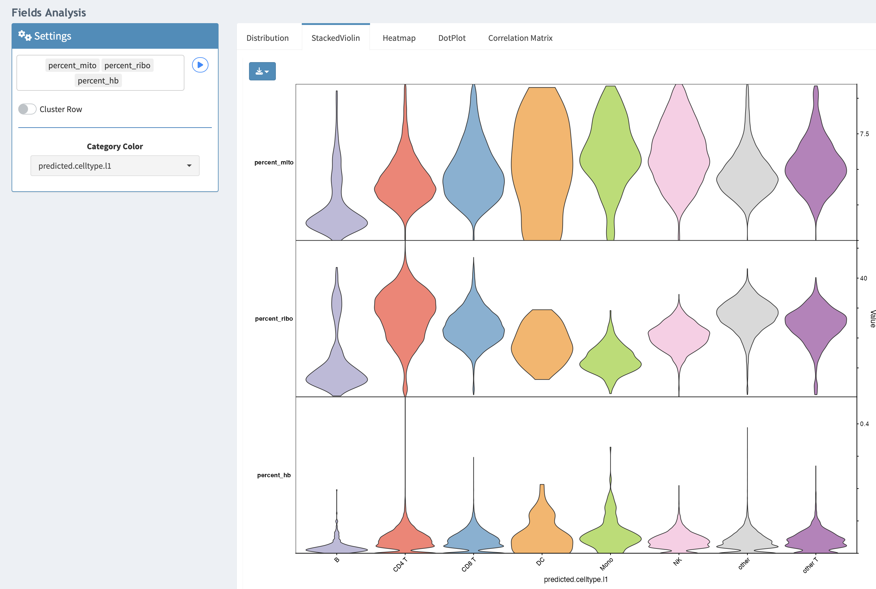
Notes:
The ’Matrix’ tab enables the generation of bivariate count tables. The ’Field’ section of this module allows the exploration of how the value of one or more continuous covariates changes concerning another variable

Slide 7
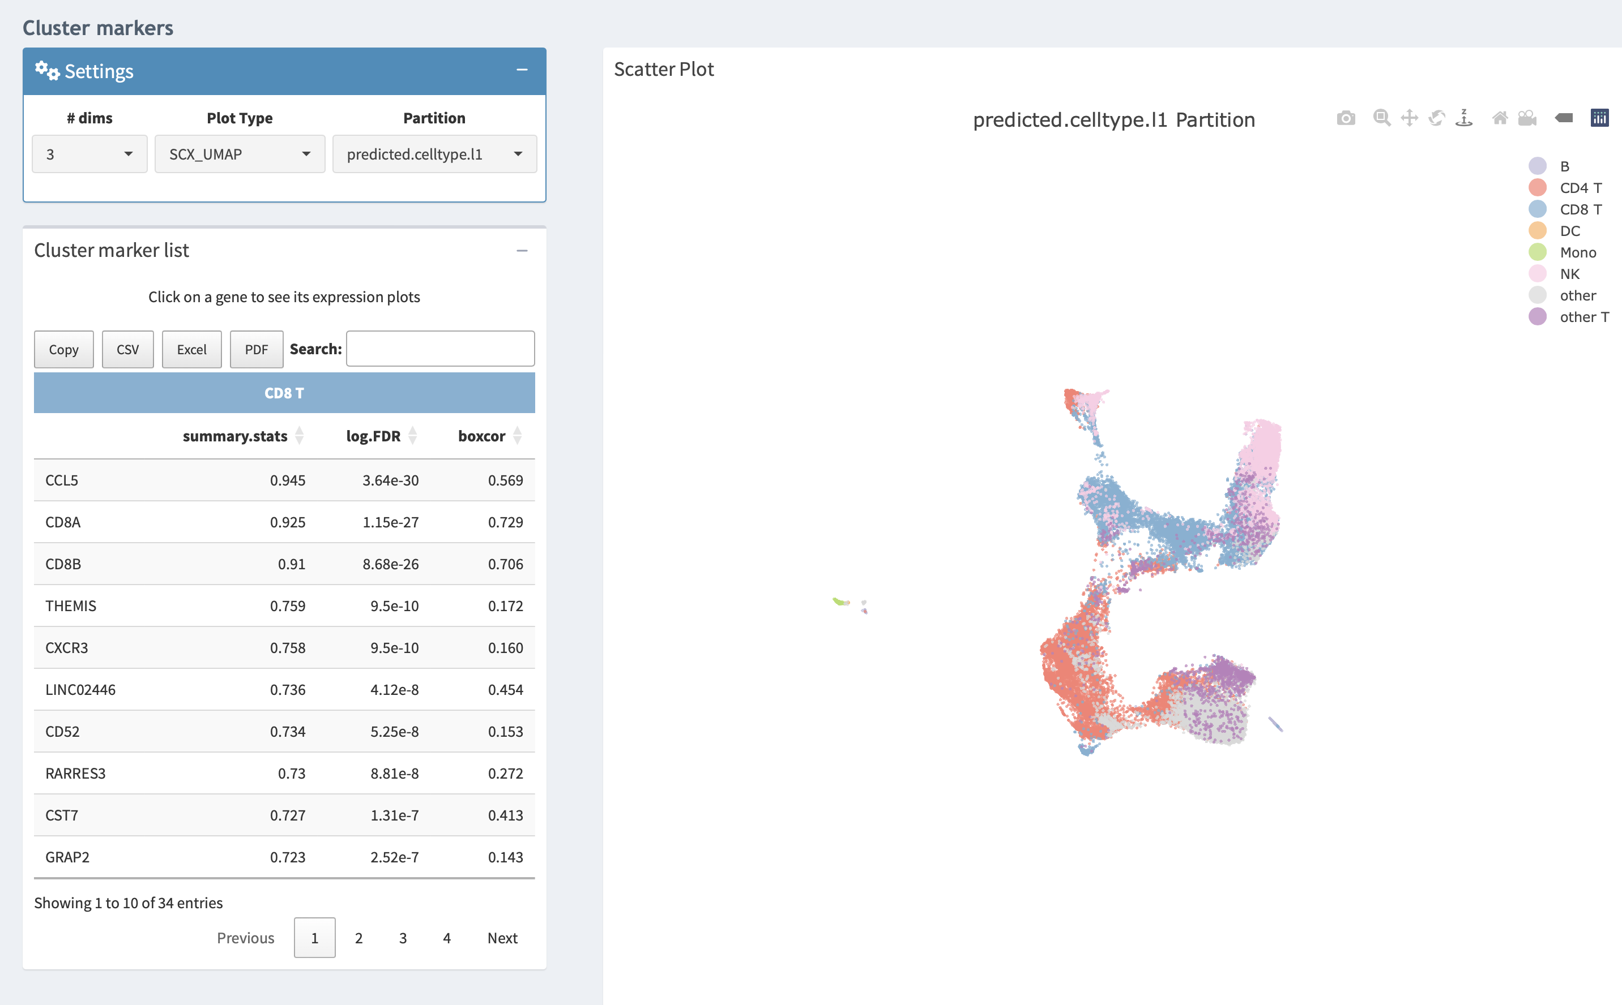
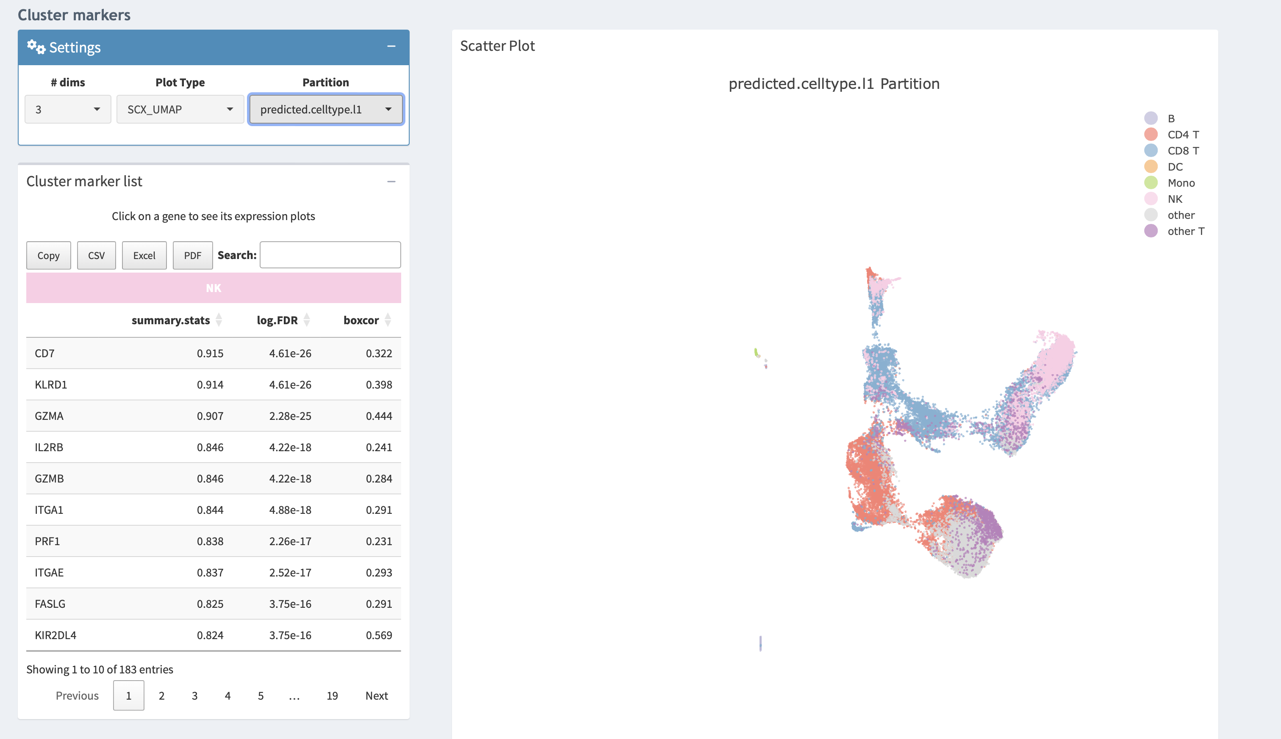
Notes:
boxcor’ is the Pearson correlation value between the gene expression profile and a binary indicator vector of the cluster of interest

Slide 8
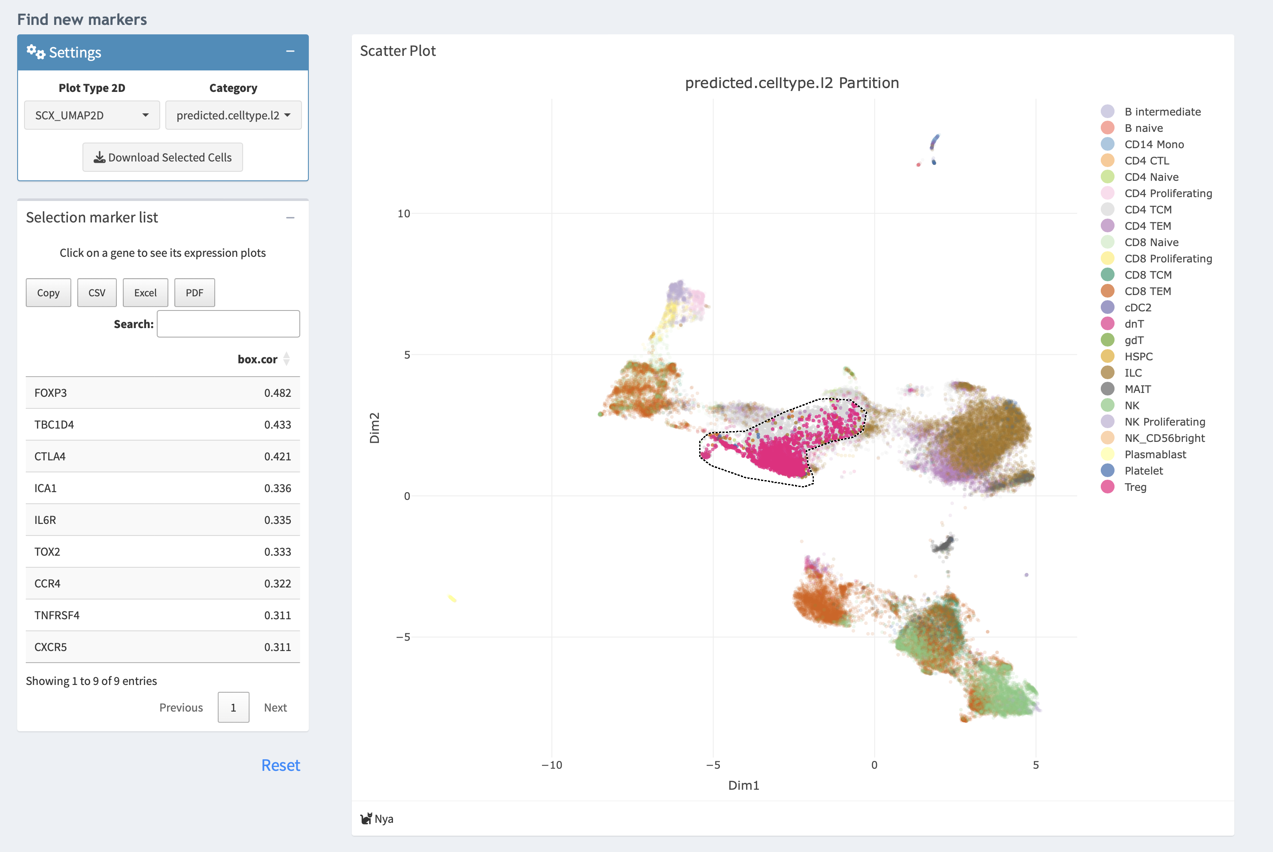
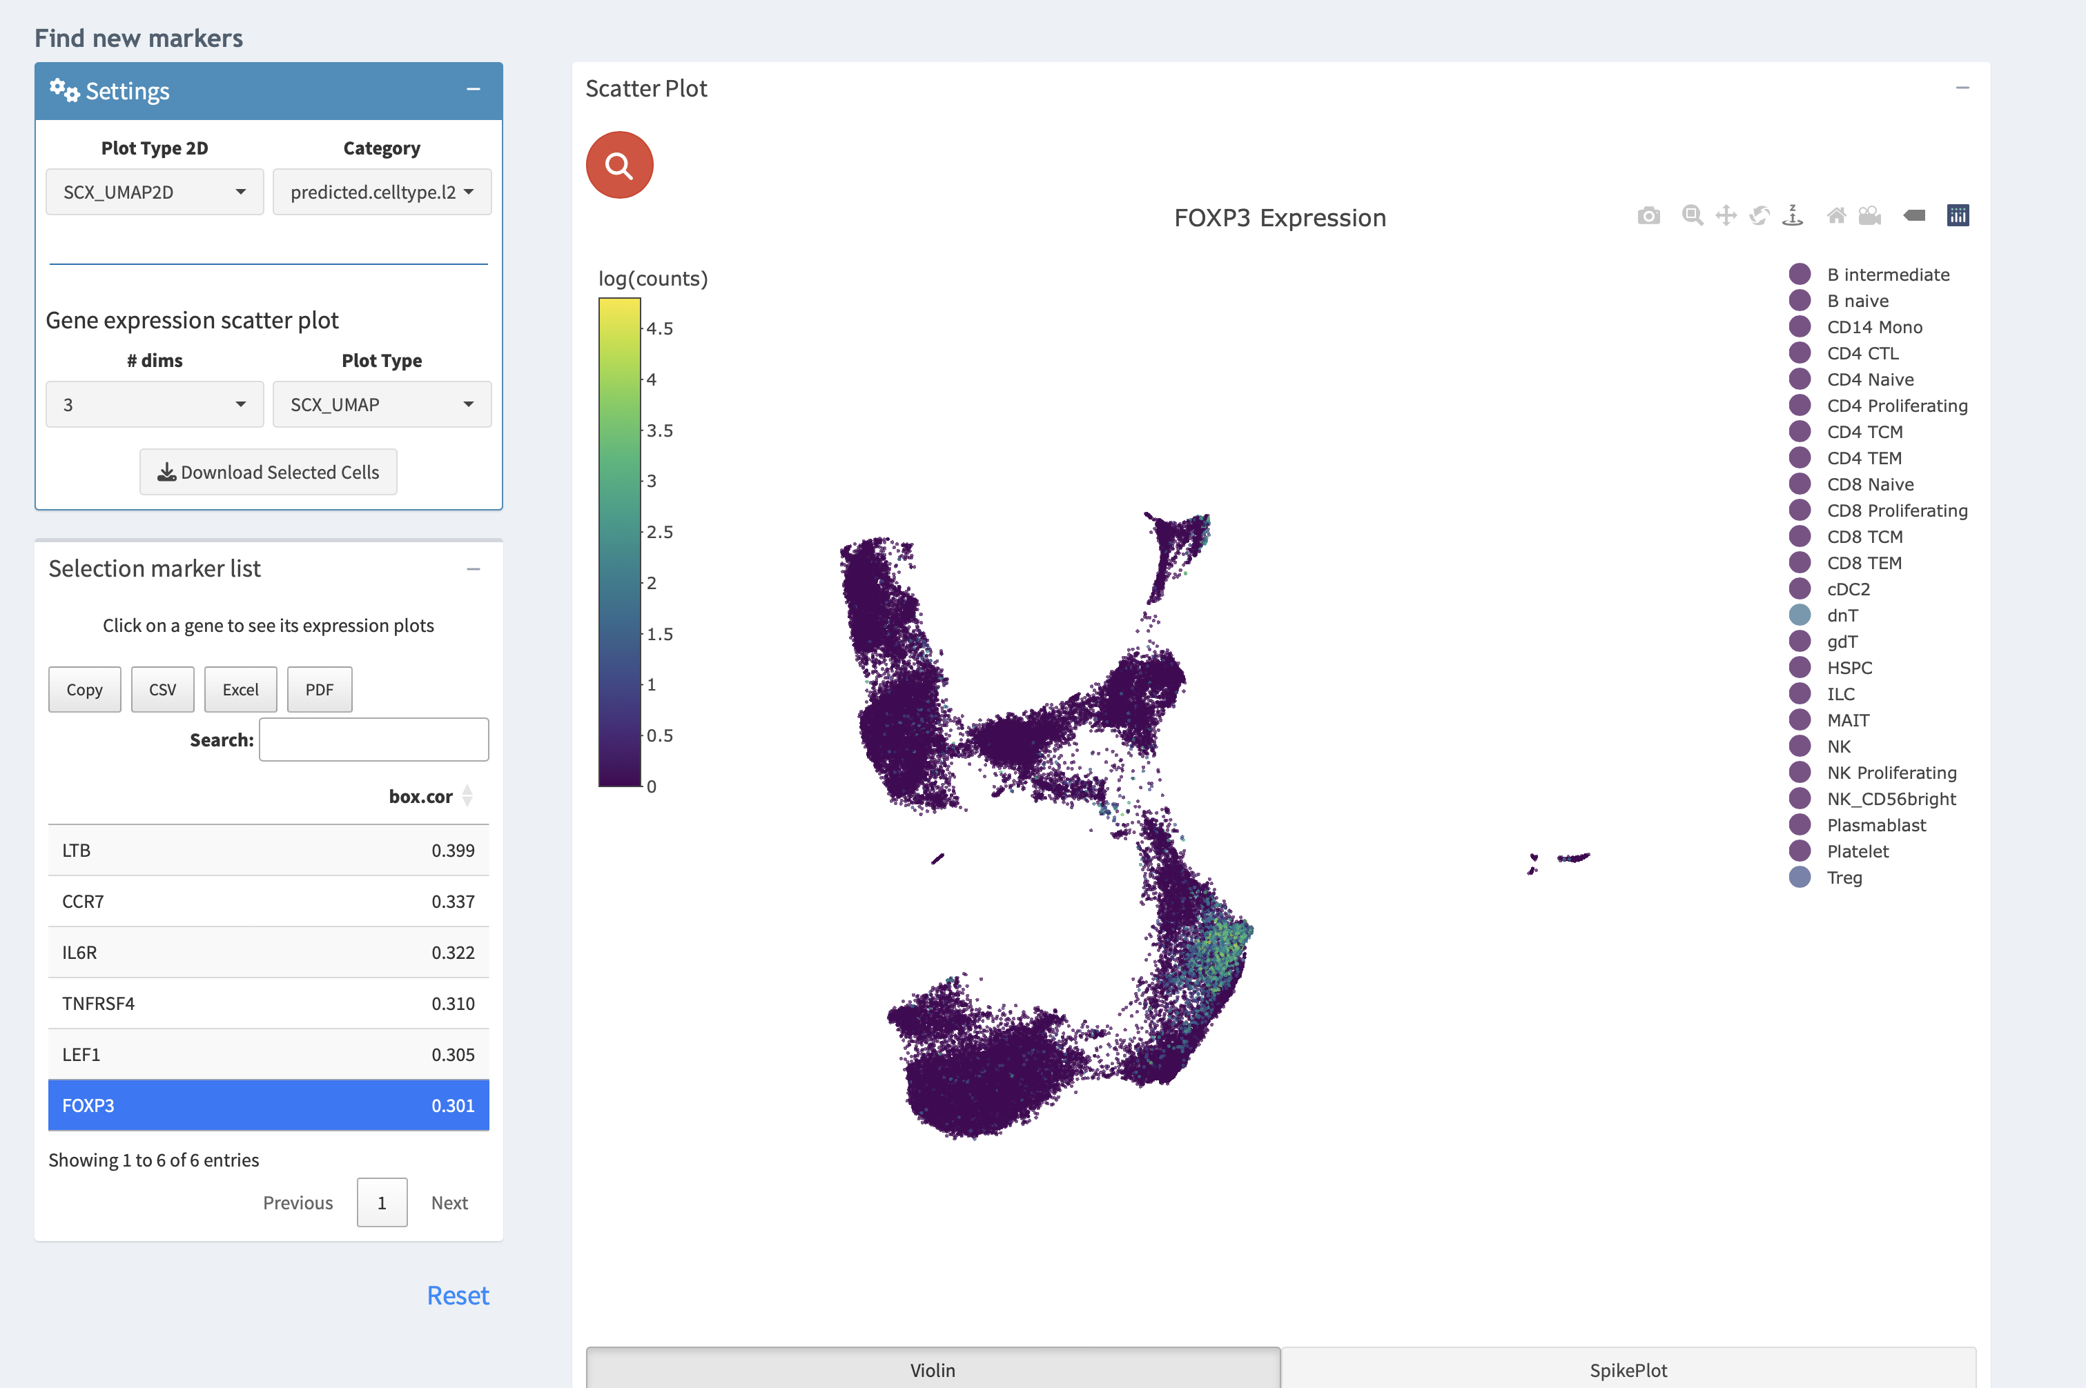
Notes:
In the ’Find new markers’ section, users can investigate markers for specific sets of cells, selected on the fly from 2D embeddings using the box or lasso tools

Slide 9
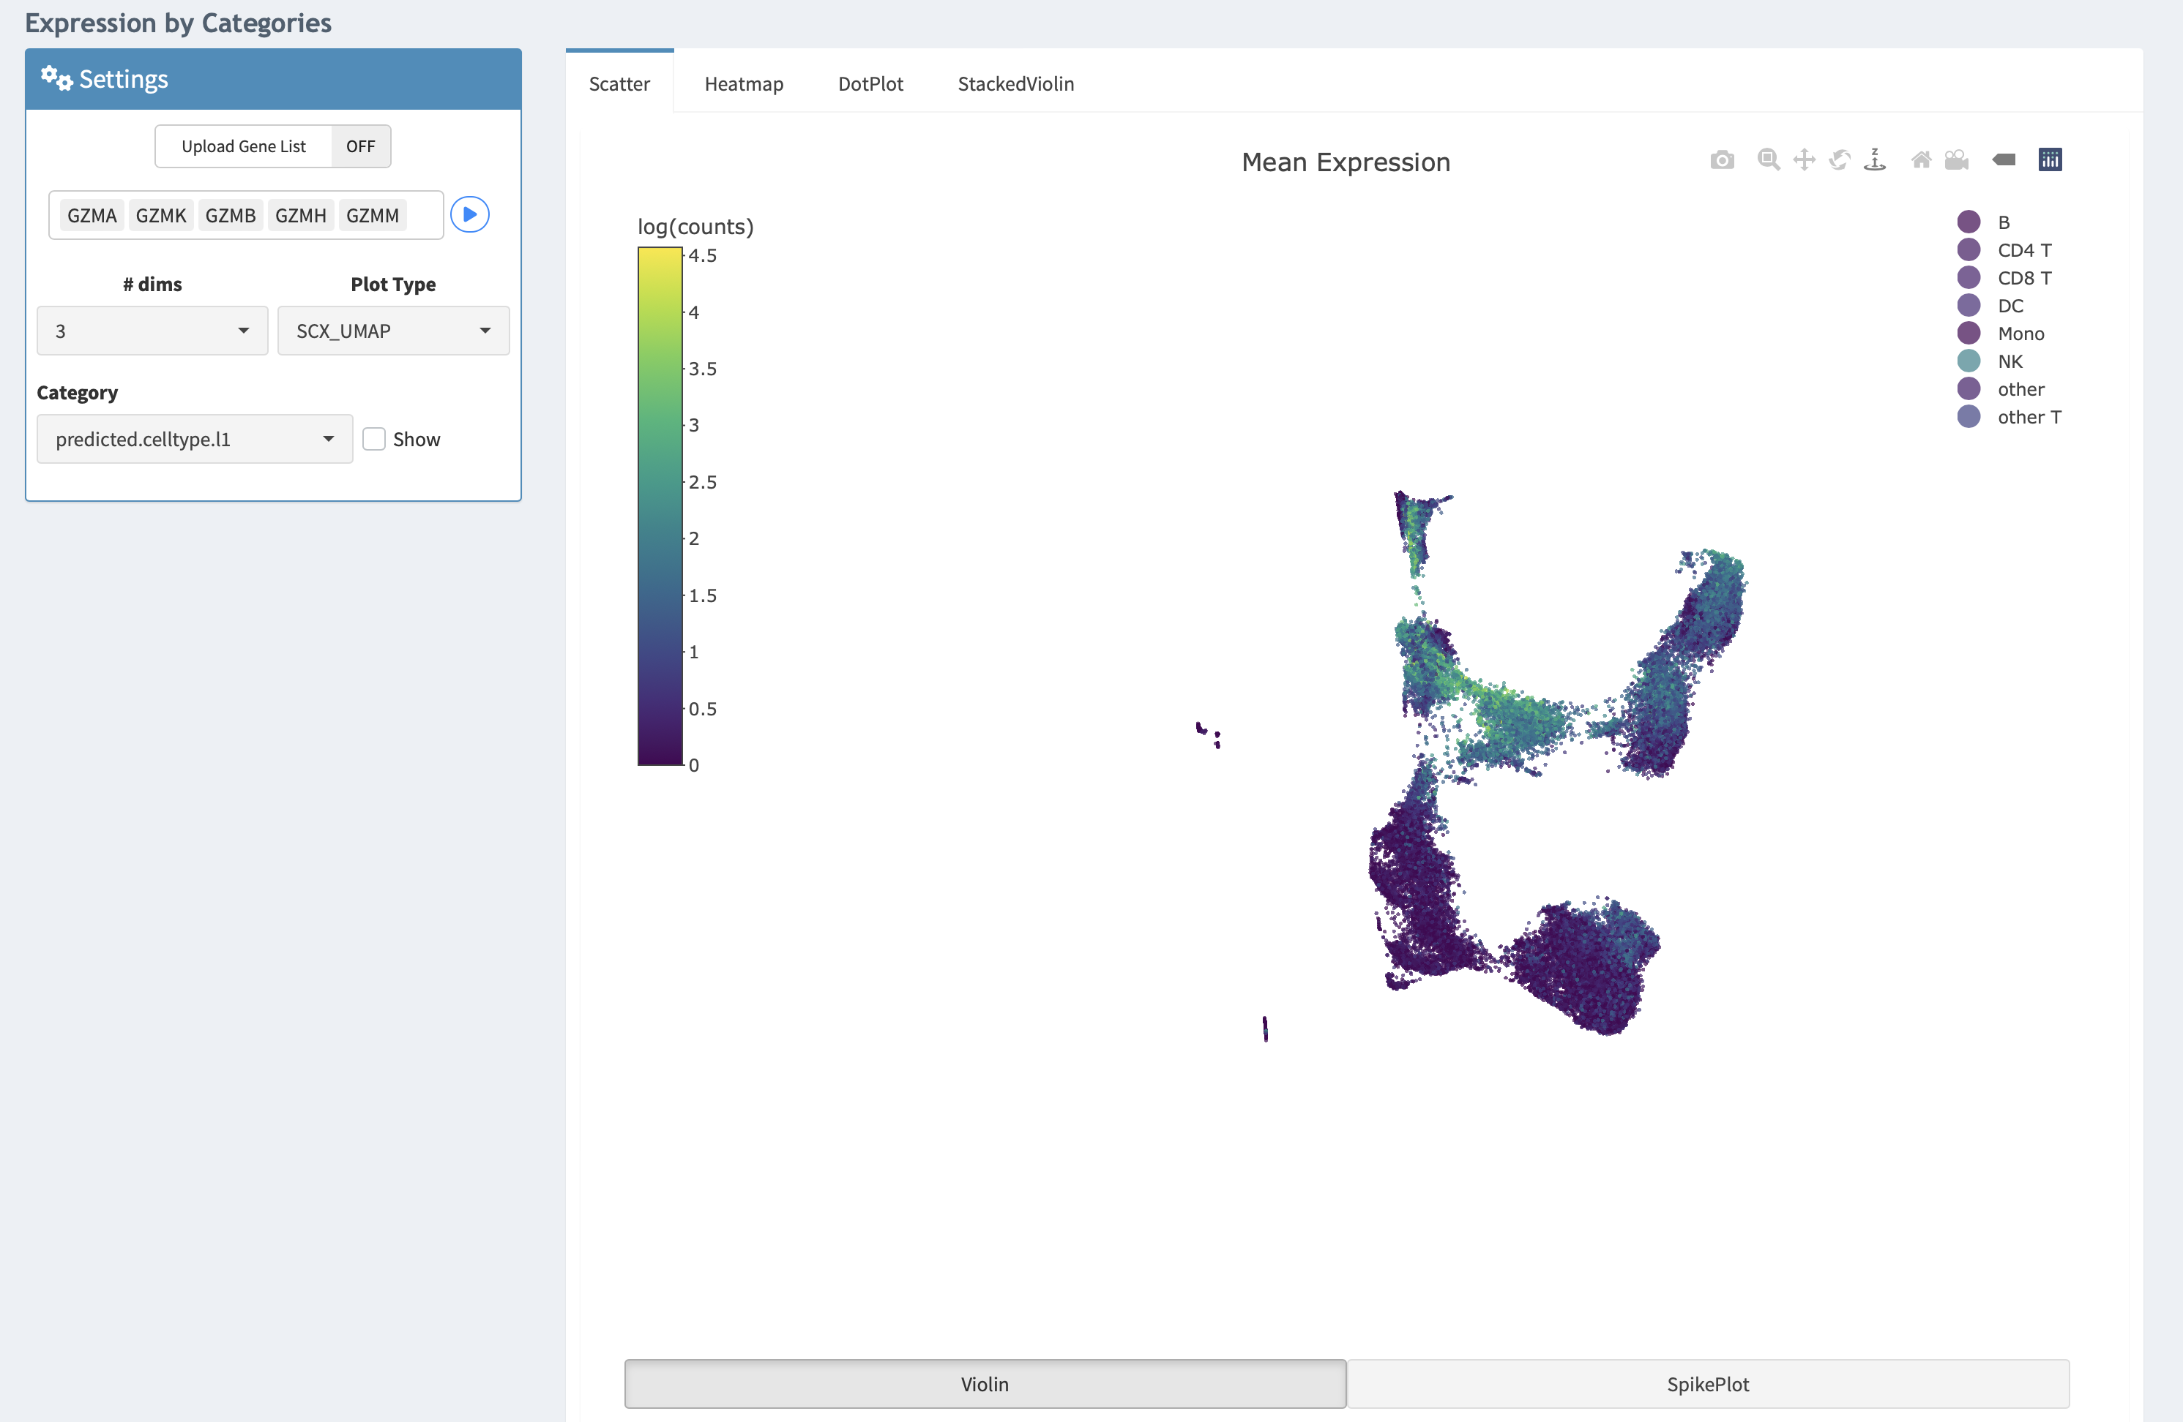
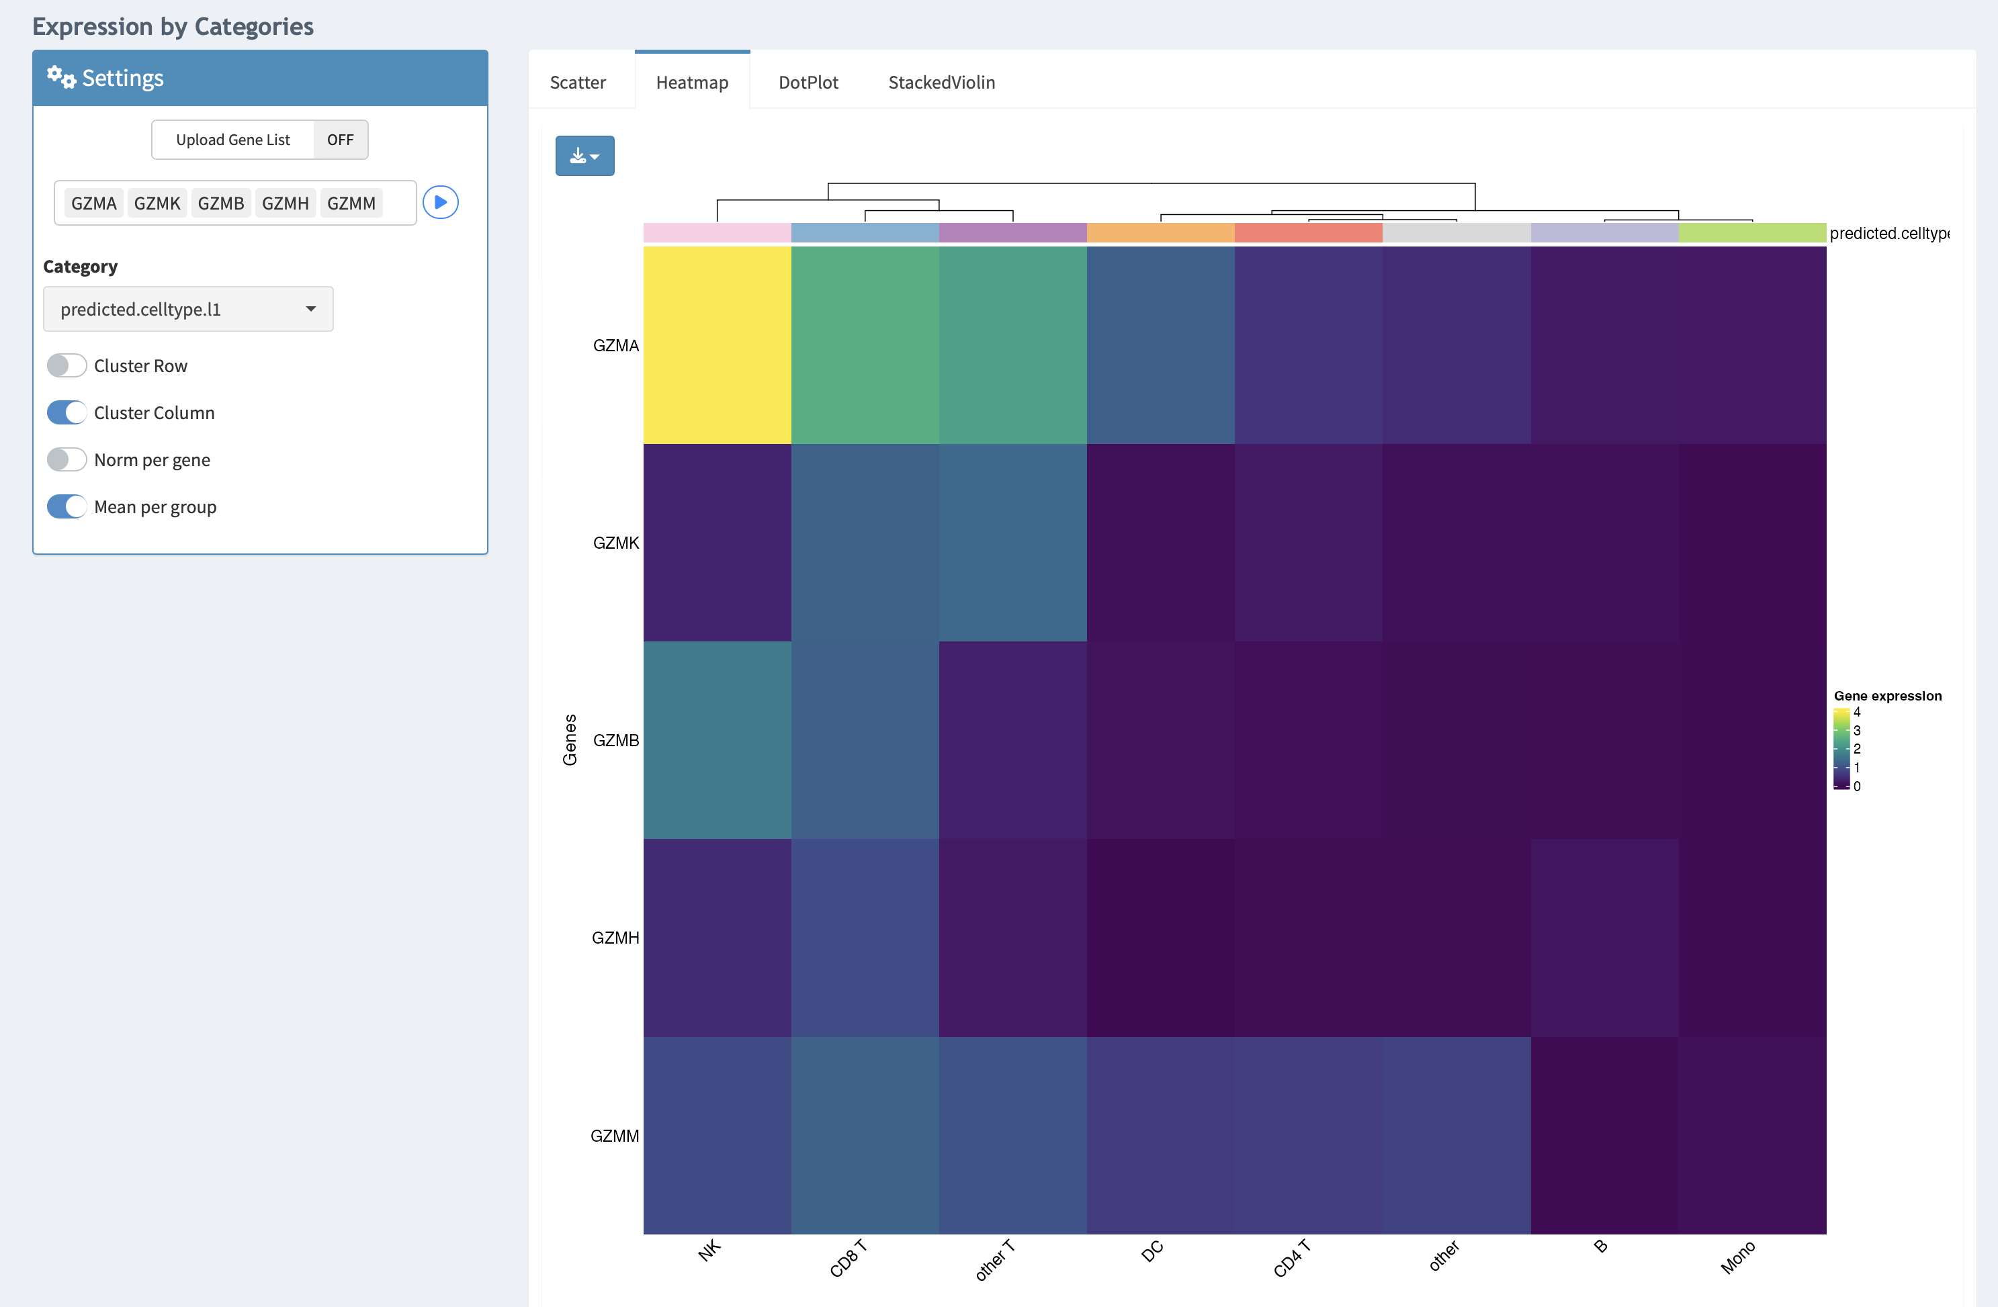

Slide 10
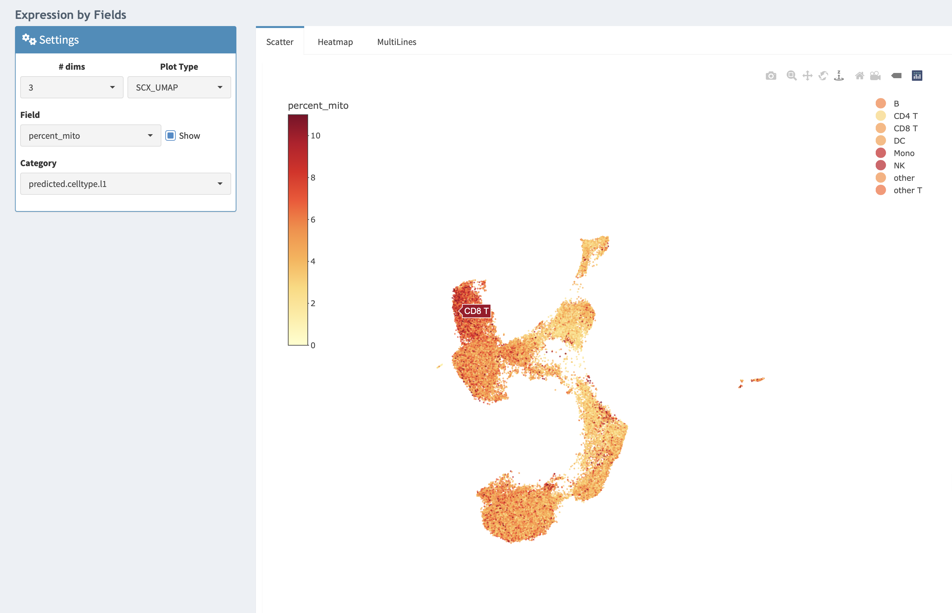

Slide 11
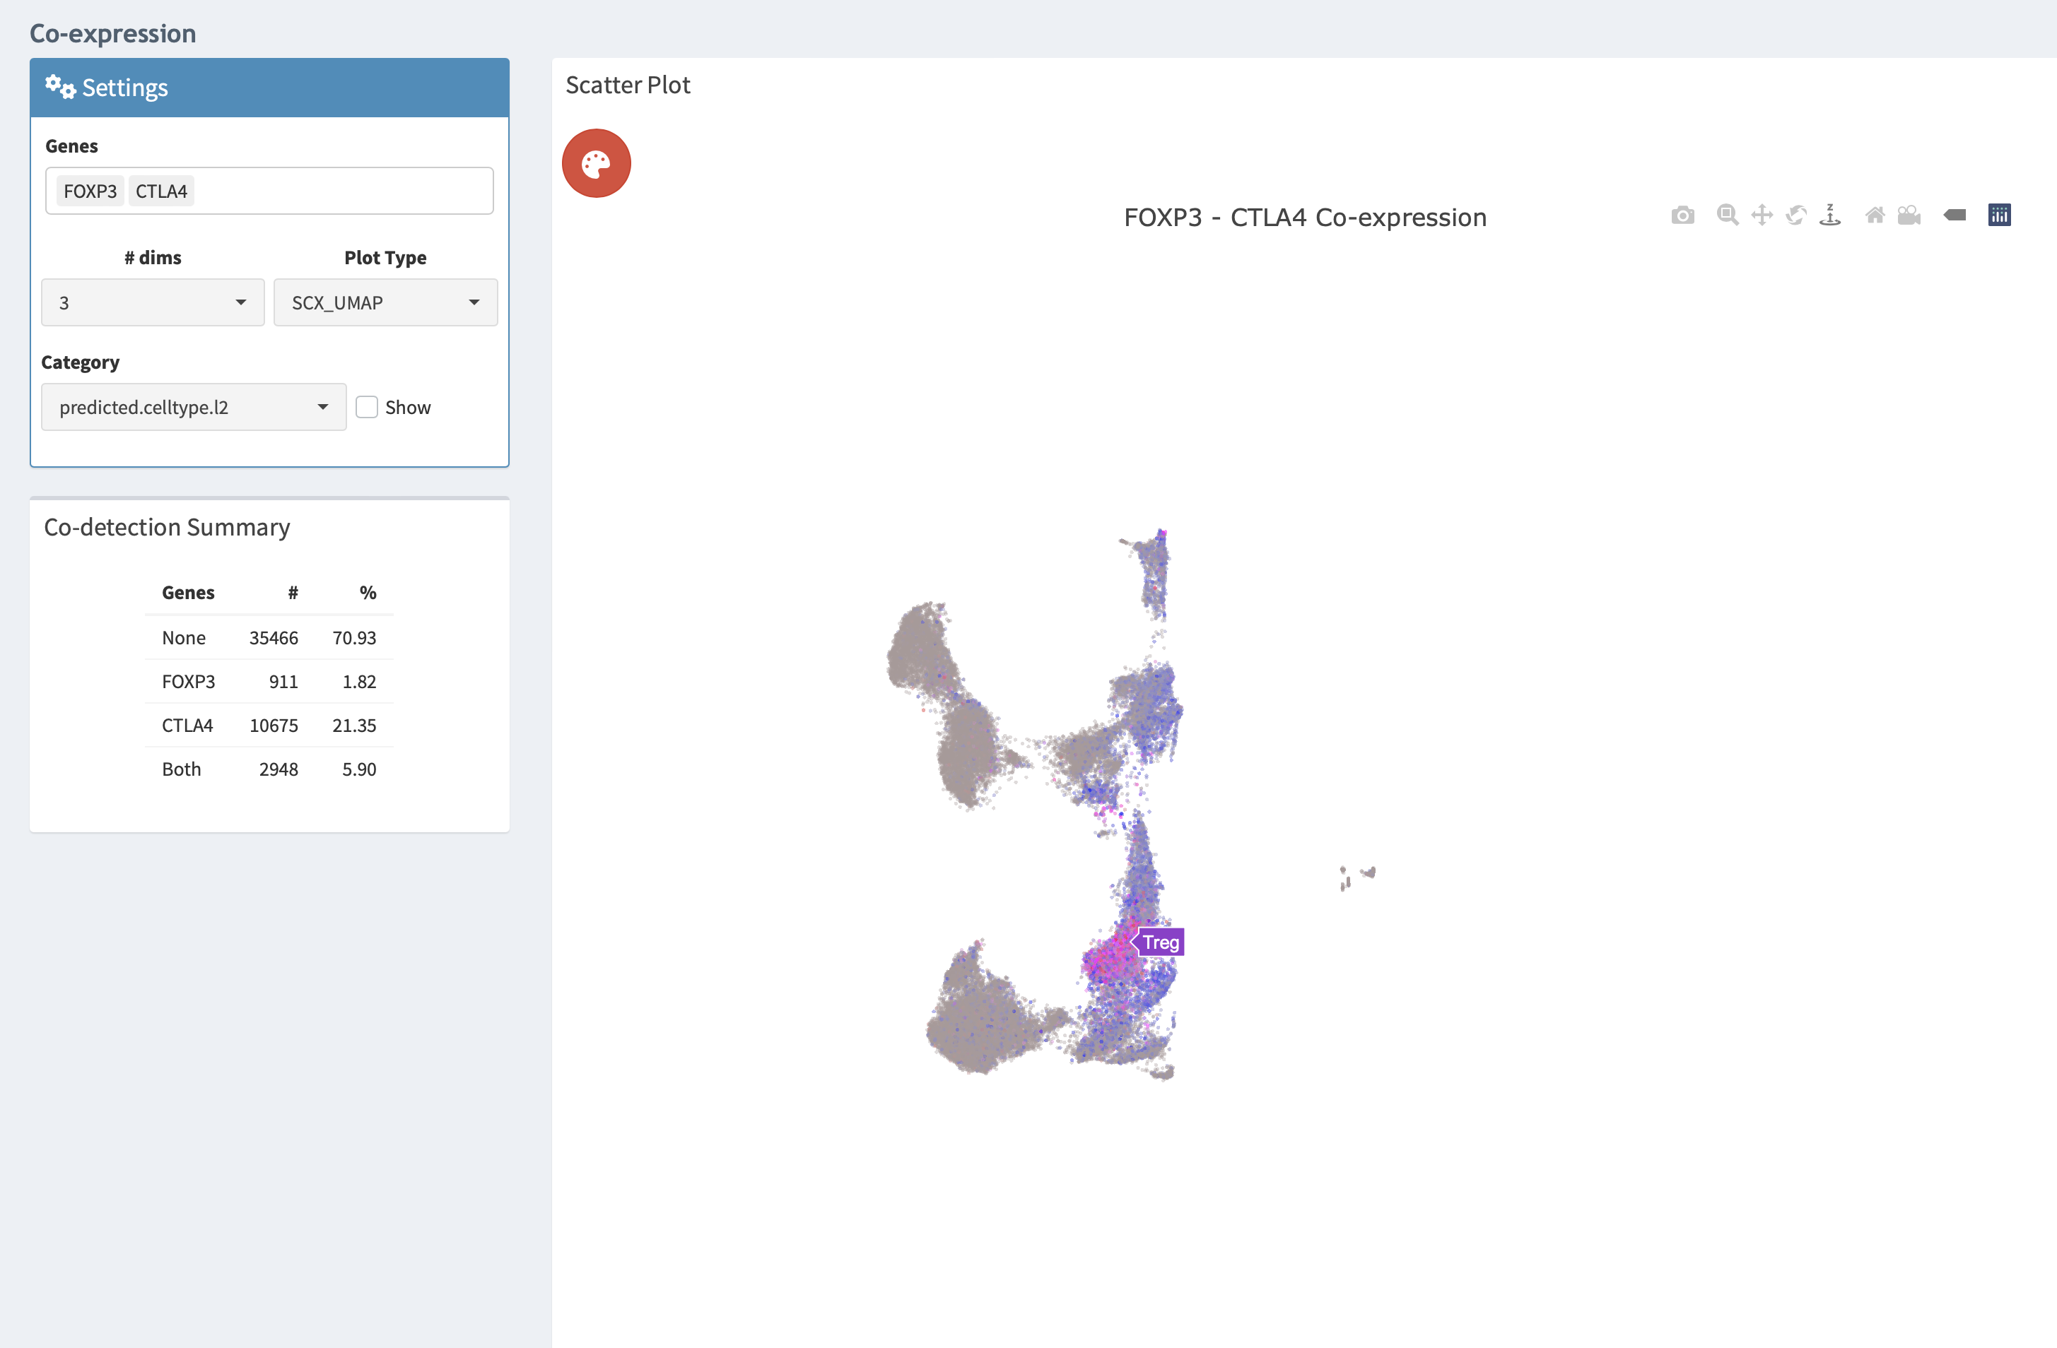

Slide 12
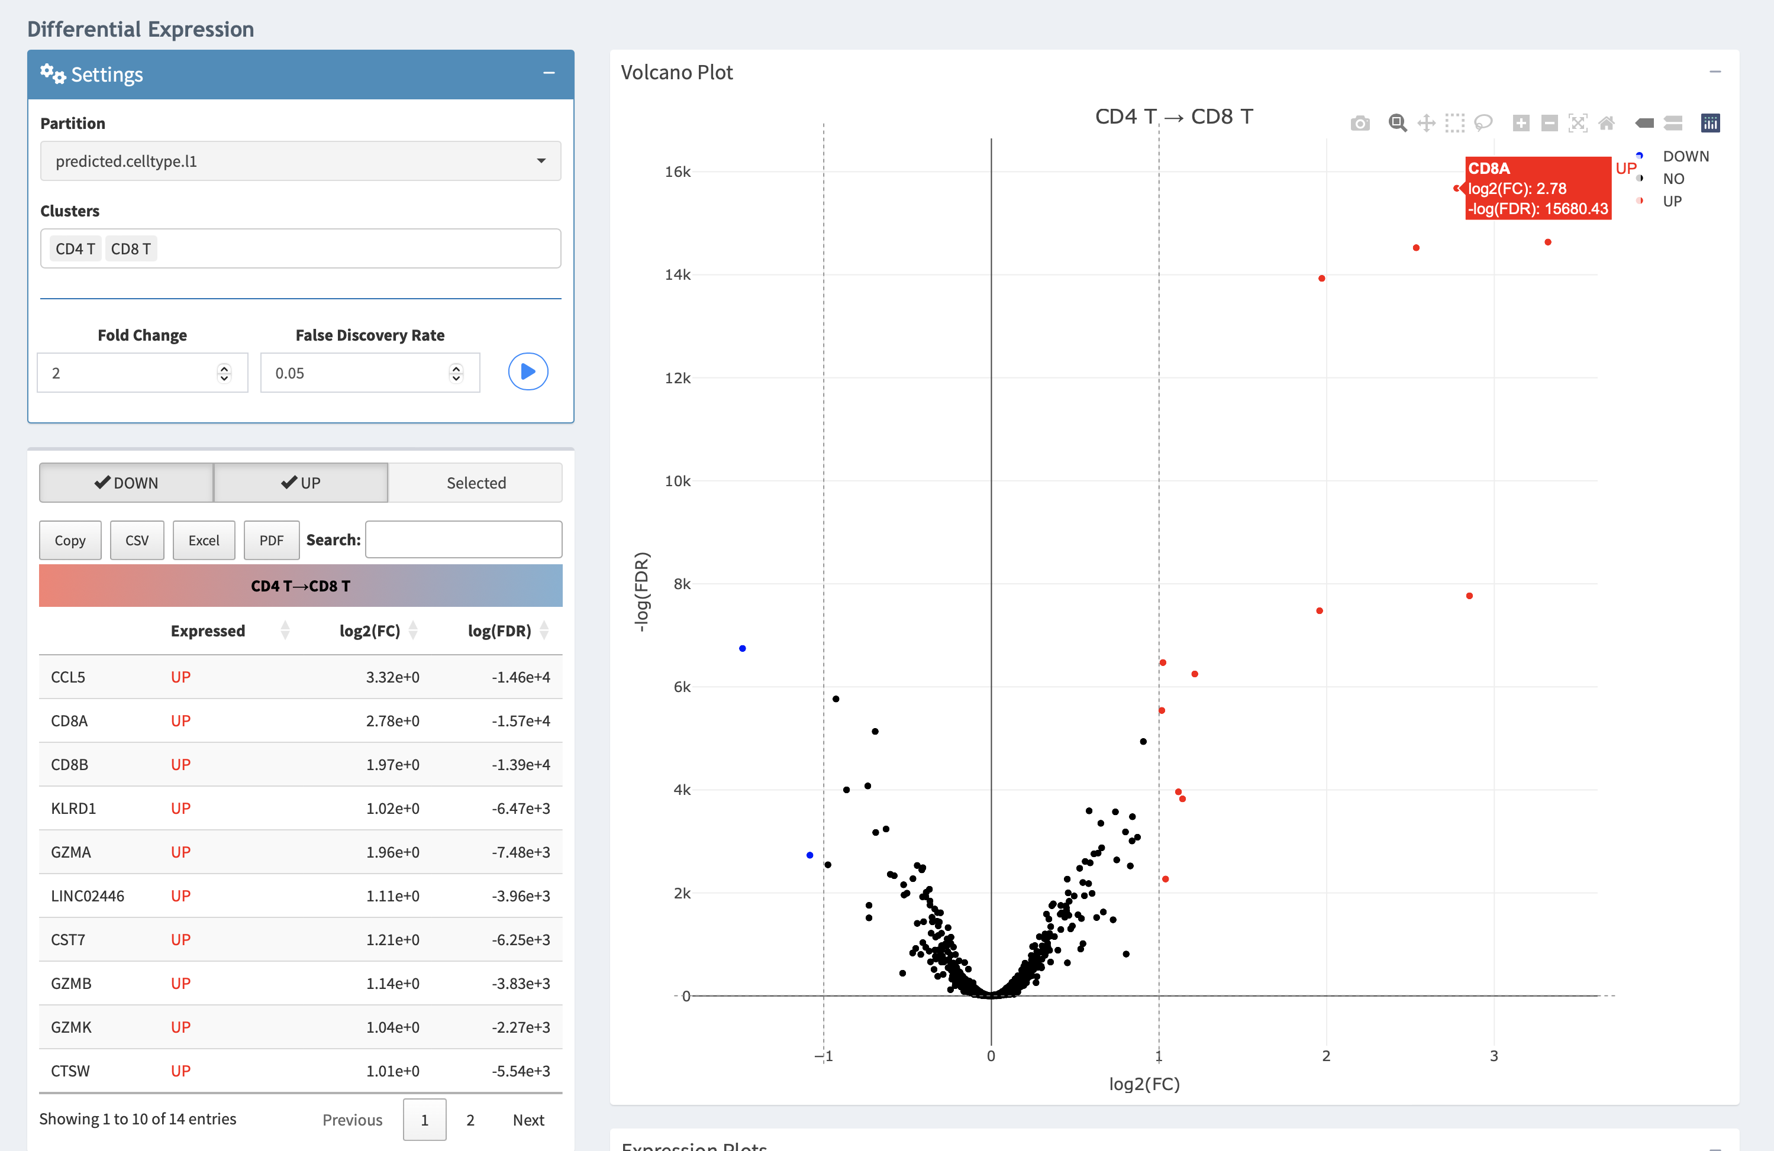

Slide 13
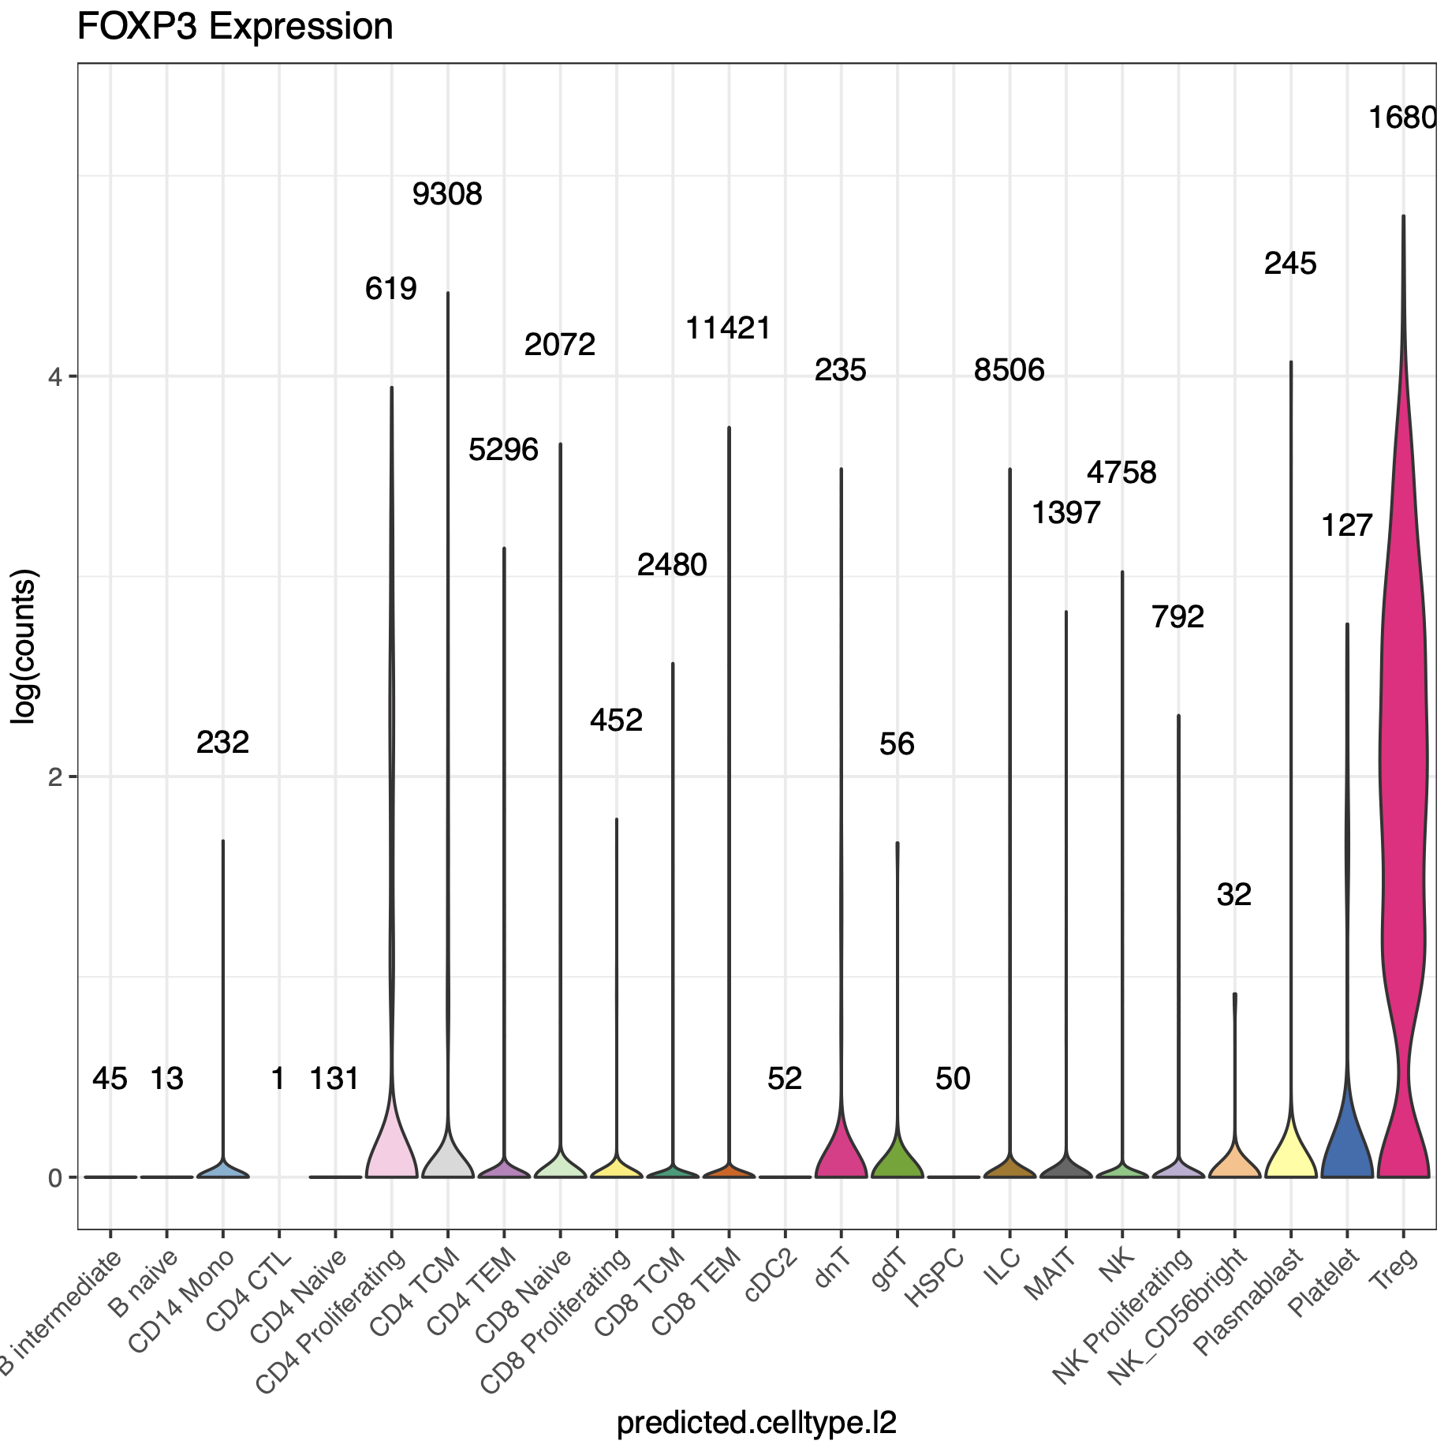

Slide 14
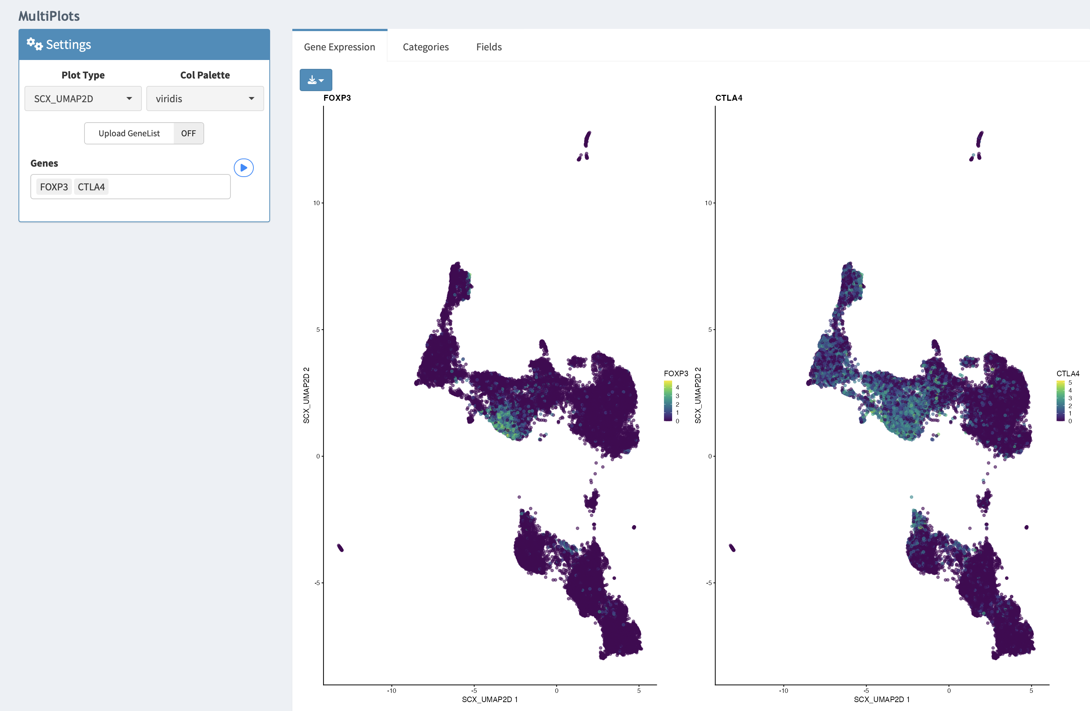

Slide 15
Proposed workflow
Bioinformatician prepares & shares object for biologist to just be able to run…
library(scX)
cseo <- readRDS(“path/to/cseo.rds")
launch_scX(cseo)

Slide 16
Caveats
createSCEobject function can take a few hours to run on larger datasets
analysis cuts off at 50k cells, bioinformatician would need to downsample if > 50k cells
Notes:
computationally demanding step (peak memory usage and run time ~= 1.3 Gb/10k cells and 10.4 minutes/10k cells)

